Slide 1
ENGINEERING MANAGEMENT
CSE 417 Section 15/AB Term II
Session 2017-18
Department of Computer Science and Engineering
Instructor: Arif S. Bhuiyan, MSEd

Slide 2
Chapter 4
Human Resource Planning and Management

Slide 3
Chapter Outline – Part II
Introduction
Human Resource Planning
Human Resource Management Systems
Training and Development Program
Motivation
Performance Management ad Appraisal
Promotion, Transfer, Demotion and Dismissal
Participative Management

Slide 4
Recruitment and Selection
Recruitment is the process of identifying the prospective employees, stimulating and encouraging them to apply for a particular job in an organization.

Slide 5
The Recruitment and Selection Process
Decide what positions you’ll have to fill through personnel planning and forecasting.
Build a pool of candidates for these jobs by recruiting internal or external candidates.
Have candidate complete application forms and perhaps undergo an initial screening interview.
Use selection techniques like tests, background investigations, and physical exams to identify viable candidates.
Decide who to make an offer to, by having the supervisor and perhaps others on the team interview the candidates.

Slide 6
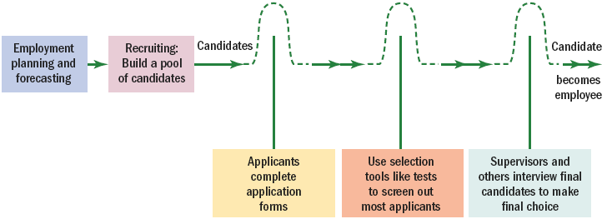
Steps in Recruitment and Selection Process
The recruitment and selection process is a series of hurdles aimed at selecting the best candidate for the job.
Figure 5–1

Slide 7
The “Big Five”
Extraversion
The tendency to be sociable, assertive, active, and to experience positive effects, such as energy and zeal.
Emotional stability/neuroticism
The tendency to exhibit poor emotional adjustment and experience negative effects, such as anxiety, insecurity, and hostility.
Openness to experience
The disposition to be imaginative, nonconforming, unconventional, and autonomous.
Agreeableness
The tendency to be trusting, compliant, caring, and gentle.
Conscientiousness
Is comprised of two related facets: achievement and dependability.

Slide 8
Basic Features of Interviews
An interview
A procedure designed to obtain information from a person through oral responses to oral inquiries
Types of interviews
Selection interview
Appraisal interview
Exit interview
Interviews formats
Structured
Unstructured

Slide 9
Types of Interviews
Selection interview
A selection procedure designed to predict future job performance on the basis of applicants’ oral responses to oral inquiries.
Appraisal interview
A discussion, following a performance appraisal, in which supervisor and employee discuss the employee’s rating and possible remedial actions.
Exit interview
An interview to elicit information about the job or related matters to the employer some insight into what’s right or wrong about the firm.

Slide 10
Formats of Interviews
Unstructured or nondirective interview
An unstructured conversational-style interview in which the interviewer pursues points of interest as they come up in response to questions.
Structured or directive interview
An interview following a set sequence of questions.

Slide 11
Interview Content: Types of Questions
Situational interview
A series of job-related questions that focus on how the candidate would behave in a given situation.
Behavioral interview
A series of job-related questions that focus on how they reacted to actual situations in the past.
Job-related interview
A series of job-related questions that focus on relevant past job-related behaviors.

Slide 12
Interview Content: Types of Questions
Stress interview
An interview in which the interviewer seeks to make the applicant uncomfortable with occasionally rude questions that supposedly to spot sensitive applicants and those with low or high stress tolerance.
Puzzle questions
Recruiters for technical, finance, and other types of jobs use questions to pose problems requiring unique (“out-of-the-box”) solutions to see how candidates think under pressure.

Slide 13
Factors Affecting Interviews
First impressions
The tendency for interviewers to jump to conclusions—make snap judgments—about candidates during the first few minutes of the interview.
Negative bias: unfavorable information about an applicant influences interviewers more than does positive information.

Slide 14
Factors Affecting Interviews (cont’d)
Misunderstanding the job
Not knowing precisely what the job entails and what sort of candidate is best suited causes interviewers to make decisions based on incorrect stereotypes of what a good applicant is.
Candidate-order error
An error of judgment on the part of the interviewer due to interviewing one or more very good or very bad candidates just before the interview in question.

Slide 15
Factors Affecting Interviews (cont’d)
Nonverbal behavior and impression management
Interviewers’ inferences of the interviewee’s personality from the way he or she acts in the interview have a large impact on the interviewer’s rating of the interviewee.
Clever interviewees attempt to manage the impression they present to persuade interviewers to view them more favorably.

Slide 16
Factors Affecting Interviews (cont’d)
Effect of personal characteristics: attractiveness, gender, race
Interviewers tend have a less favorable view of candidates who are:
Physically unattractive
Female
Of a different racial background
Disabled

Slide 17
Factors Affecting Interviews (cont’d)
Interviewer behaviors affecting interview outcomes
Inadvertently telegraphing expected answers.
Talking so much that applicants have no time to answer questions.
Letting the applicant dominate the interview.
Acting more positively toward a favored (or similar to the interviewer) applicant.

